Slide 1

Sex-specific translational control
Identification of SXL co-factors and mRNA targets
Antoine Graindorge
Gene Regulation, Stem Cells and Cancer Programme
Center for Genomic Regulation (CRG)
Barcelona

Slide 2
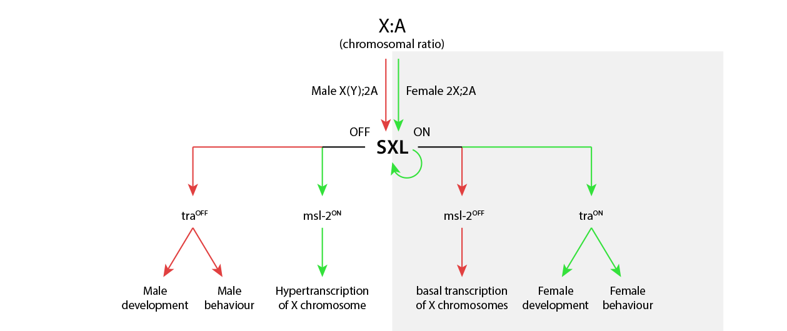


Sex determination, chromosome composition and SXL
(Adapted from Penalva and Sanchez, 2003)

Slide 3
Sex determination, chromosome composition and SXL
Other
1
2
mRNAs?
1
Mechanism of msl2 translation inhibition? Identification of SXL interactions
2
Other mRNAs inhibited in female flies? Identification of SXL targets
(Adapted from Penalva and Sanchez, 2003)

Slide 4
Plan
Identification of SXL interactions
Introduction
(a) Dosage compensation and the need to repress Msl2 in females
(b) Translation initiation
(c) The paradigm of msl2 translational repression
Purification of SXL mRNP complexes
(d) Two-steps mRNP purification
(e) 5’UTR SXL co-factor: Held-Out-Wing
(f) 3’UTR SXL co-factor: Hrp48
SXL mRNA targets: Seeking for genes involved in sex determination
(g) Introduction
(h) mRNAs interacting with SXL
(i) Perspectives

Slide 5
Plan
Identification of SXL interactions
Introduction
(a) Dosage compensation and the need to repress Msl2 in females
(b) Translation initiation
(c) The paradigm of msl2 translational repression
Purification of SXL mRNP complexes
(d) Two-steps mRNP purification
(e) 5’UTR SXL co-factor: Held-Out-Wing
(f) 3’UTR SXL co-factor: Hrp48
SXL mRNA targets: Seeking for genes involved in sex determination
(g) Introduction
(h) mRNAs interacting with SXL
(i) Perspectives

Slide 6
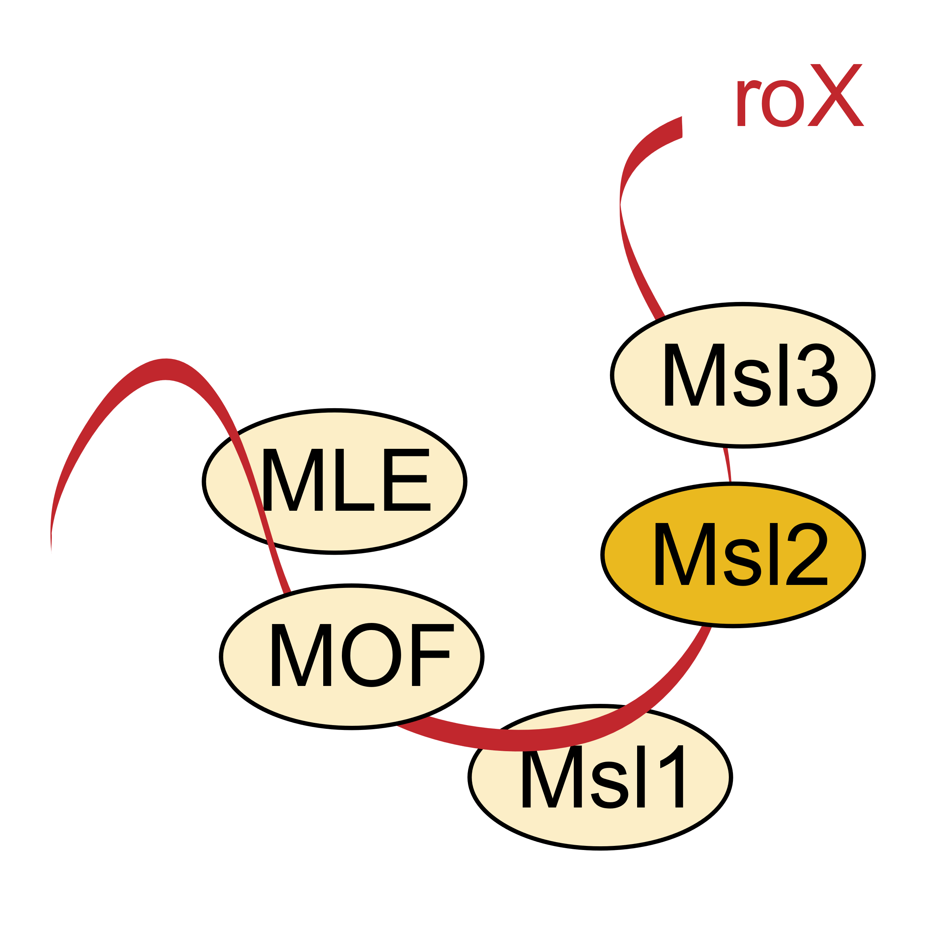
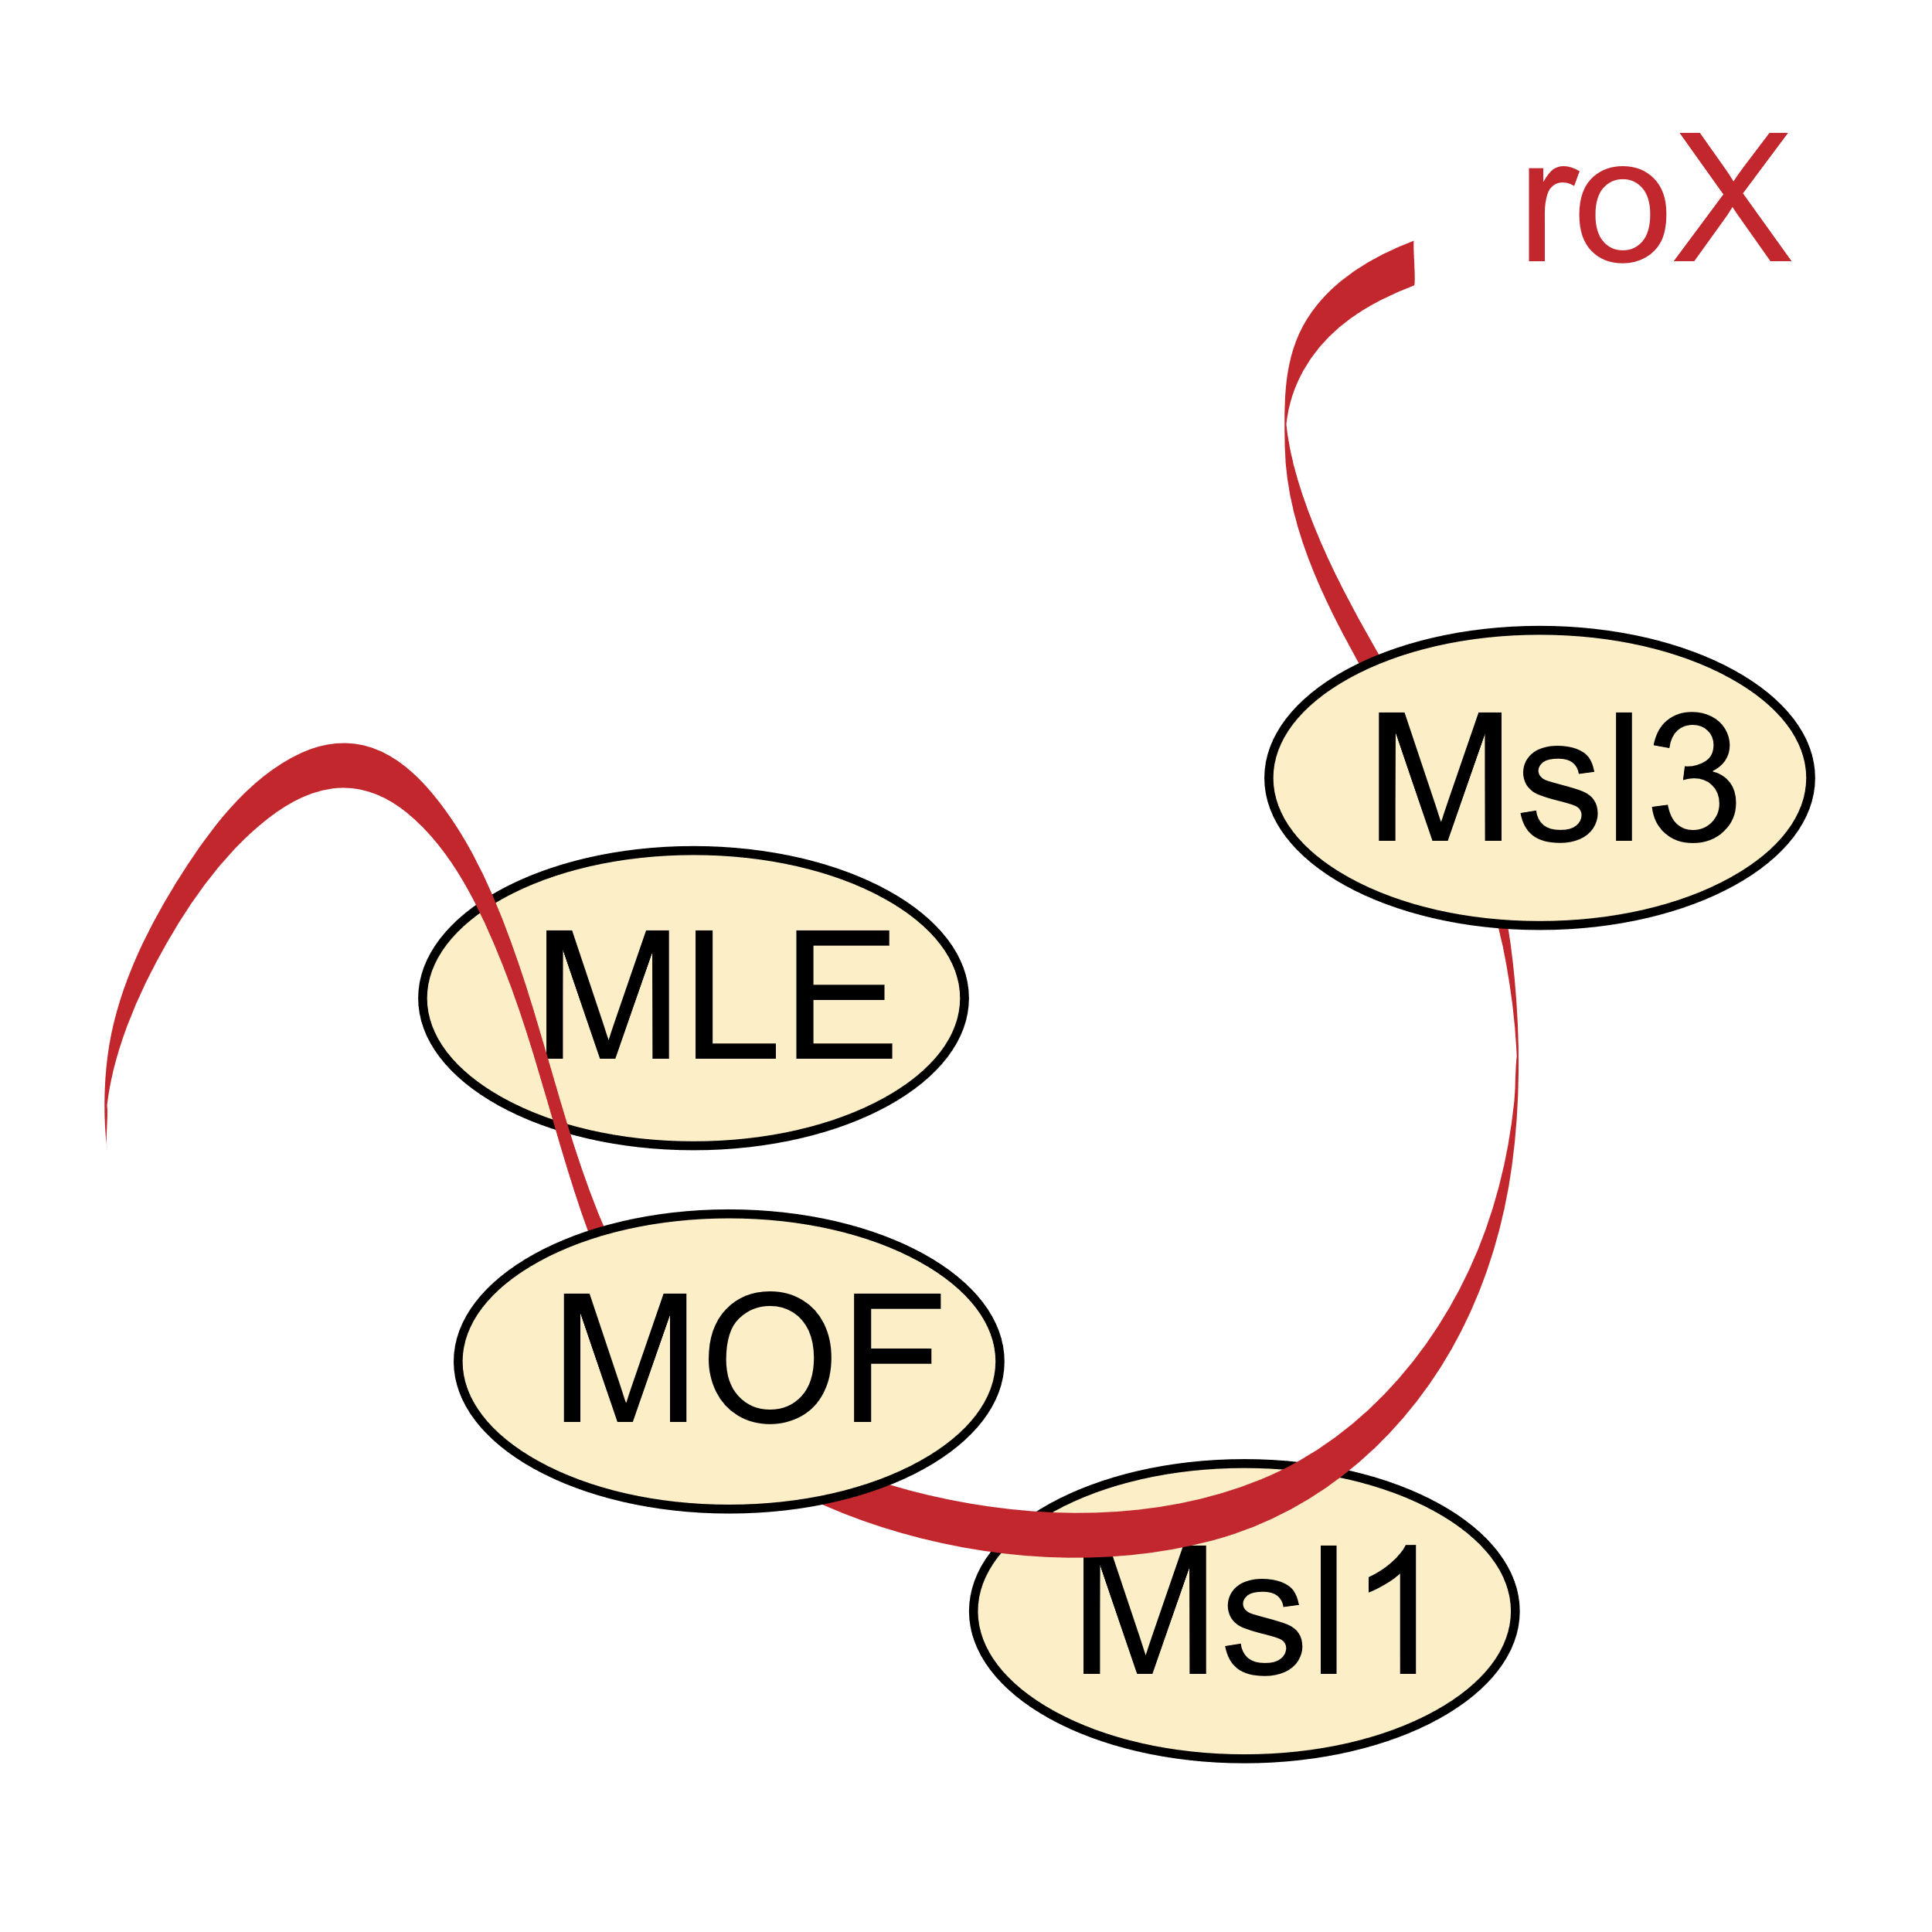
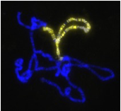
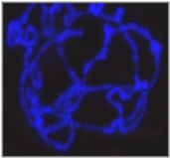
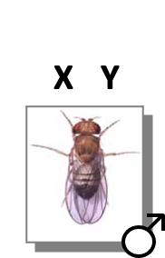
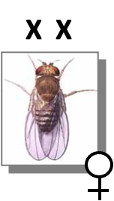
Dosage compensation and the need to repress Msl2 in females
DOSAGE COMPENSATION
Msl2
Hypertranscription
Normal transcription
of Male X chromosome
of both X chromosomes
X

Slide 7
Dosage compensation and the need to repress Msl2 in females
Translation
repression
Msl2
Normal transcription
of both X chromosomes

Slide 8
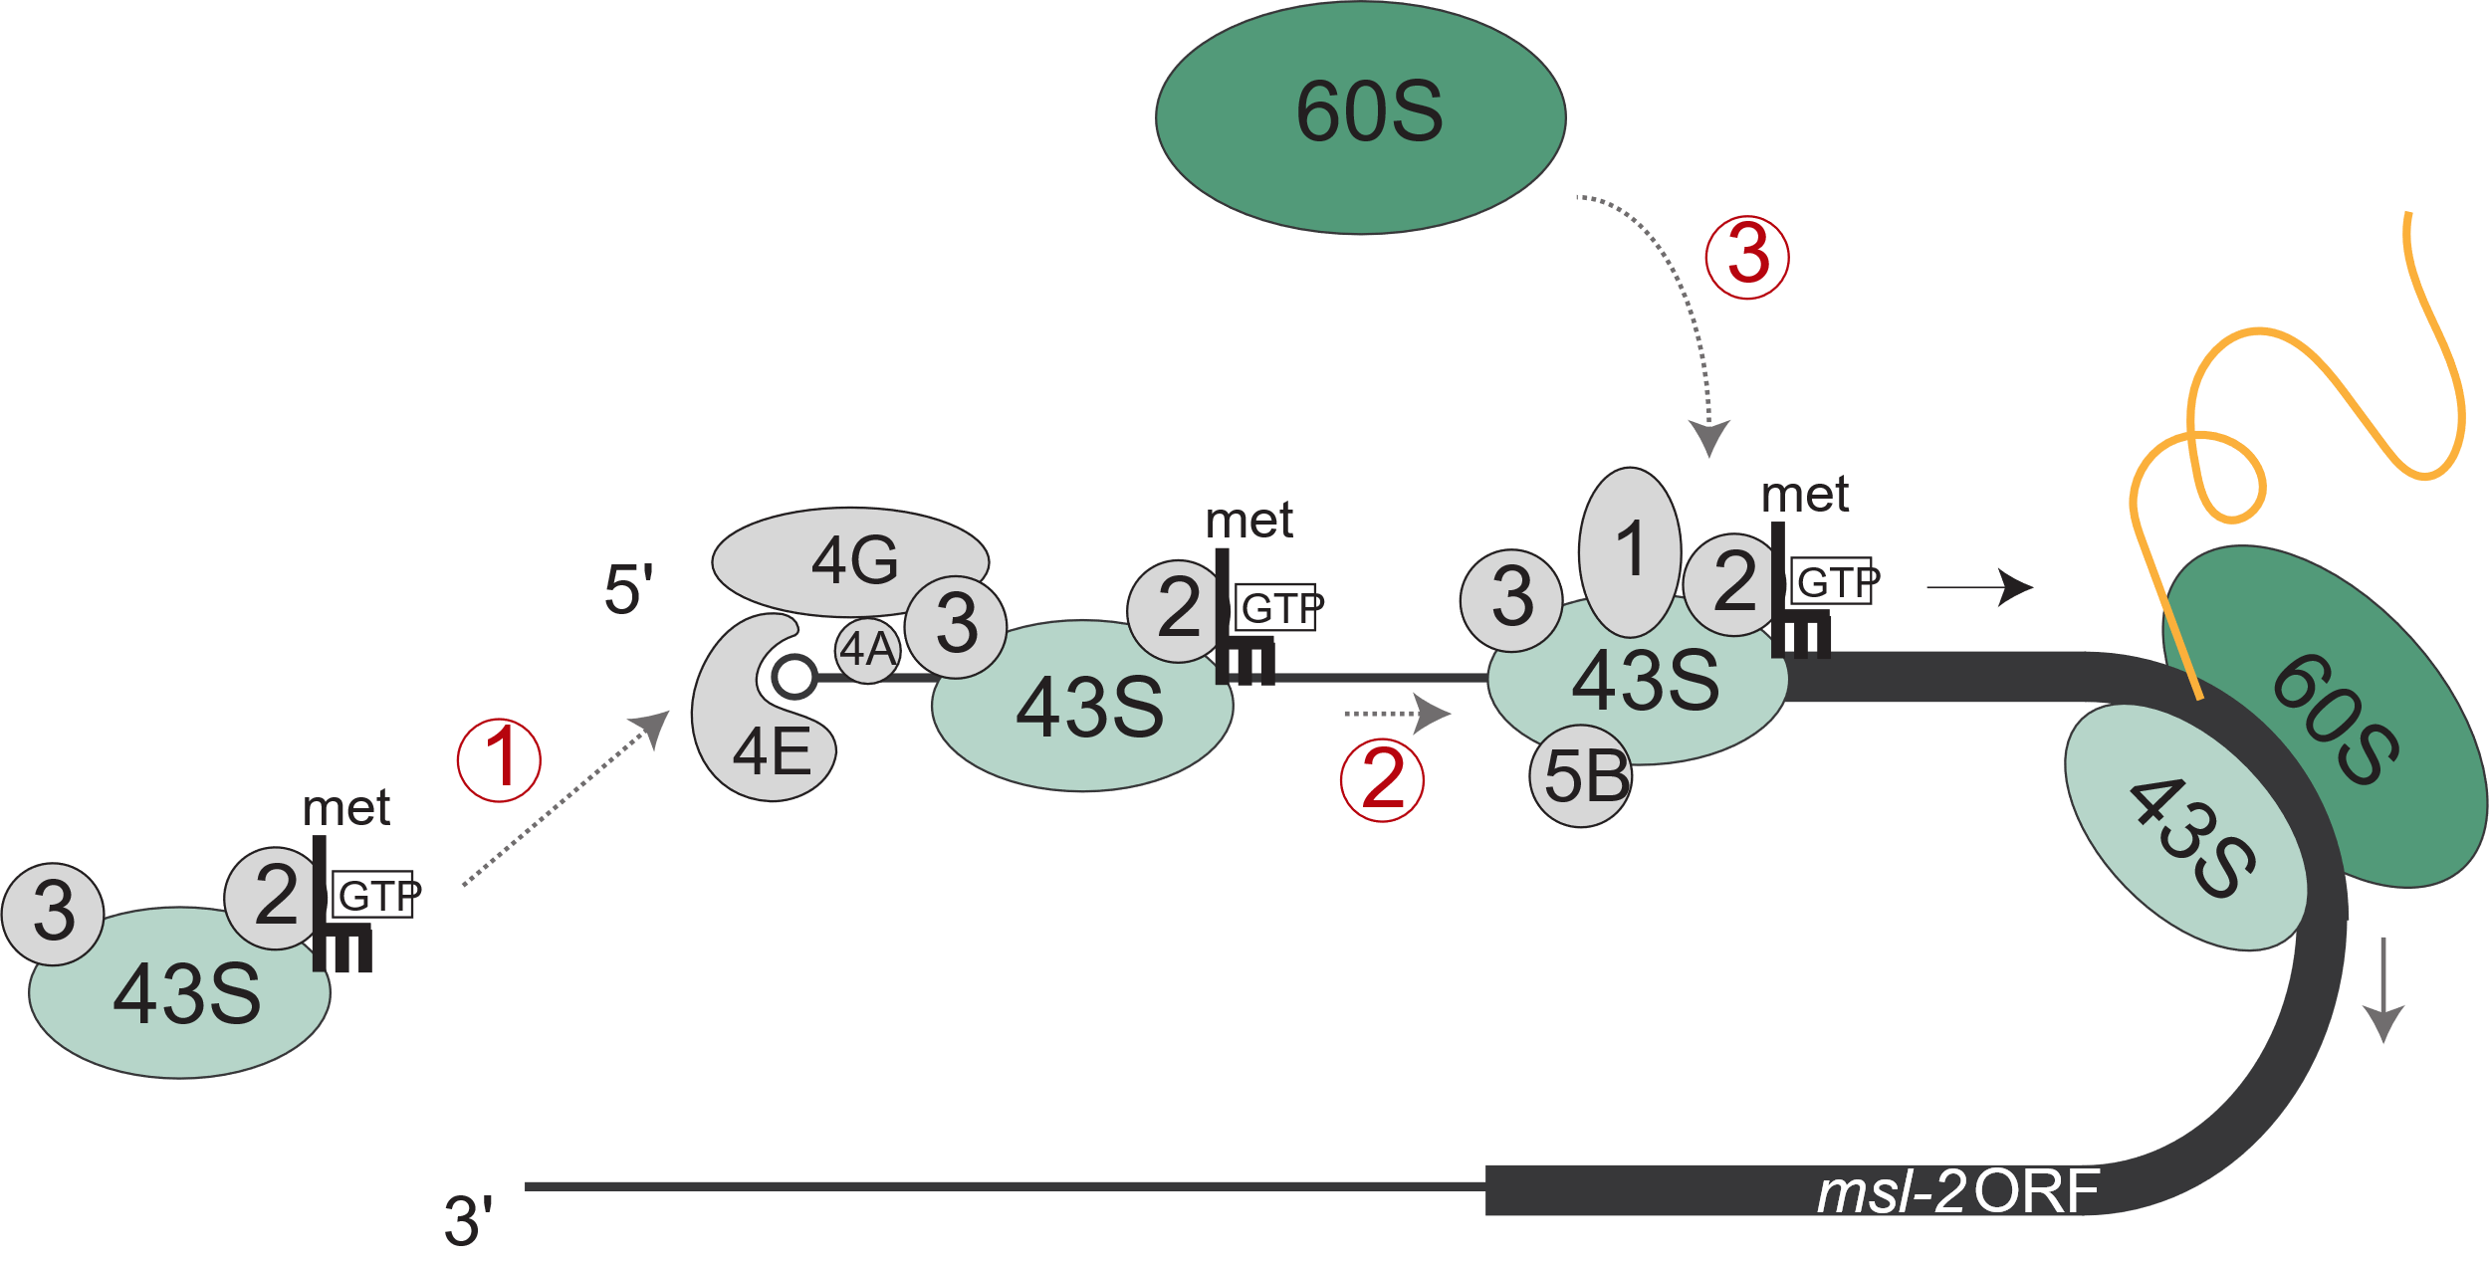
Translation initiation
Msl2
Functional DCC
Hypertranscription
1
43S ribosomal subunit recruitment to the cap
of the x chromosome
2
43S scanning along the 5’UTR until AUG codon
3
60S subunit joining

Slide 9
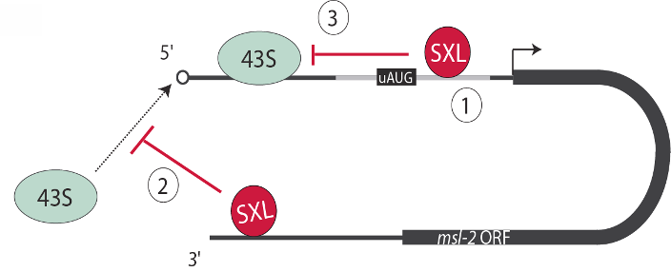
The paradigm of msl2 transition repression
Sex-Lethal (SXL), a female-specific RNA-binding protein that inhibits msl2 translation
Msl2
Non functional DCC
Three steps to lock msl2 translation:
Normal transcription
of both x chromosomes
1
Inclusion of a female-specific 5’UTR sequence
2
Inhibition of the 43S recruitment (via 3’UTR SXL)
3
Blockage of the 43S scanning (via 5’UTR SXL)

Slide 10
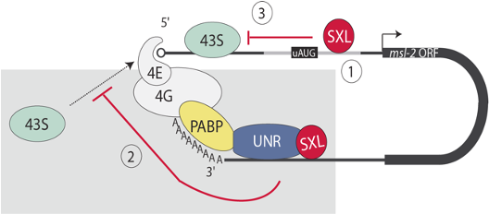
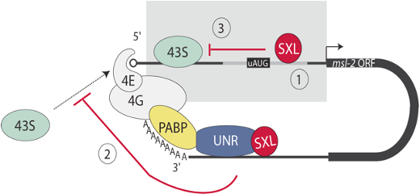
The paradigm of msl2 transition repression
3’UTR-mediated
5’UTR-mediated
SXL uses two different mechanisms to lock msl2 translation.

Slide 11
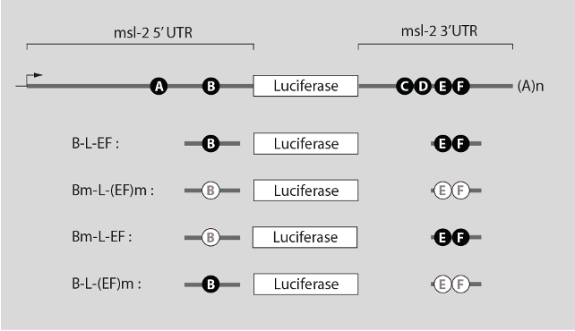
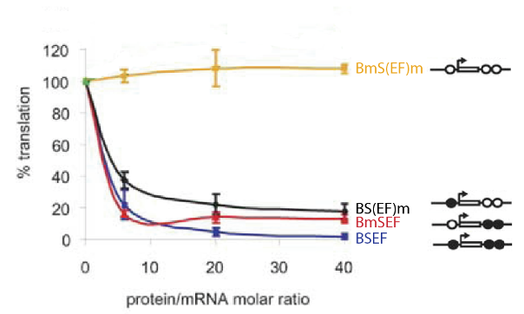
The paradigm of msl2 transition repression
SXL binding sites:
- poly(U) stretches
- in the 5’UTR (A, B) and 3’UTR (C,D,E,F)
B, E and F sites required for the full repression:
- In vitro translation assays
- drosophila embryo extract + dSXL + reporter RNAs
(Beckmann et al, 2005)

Slide 12
Plan
Identification of SXL interactions
Introduction
(a) Dosage compensation and the need to repress Msl2 in females
(b) Translation initiation
(c) The paradigm of msl2 translational repression
Purification of SXL mRNP complexes
(d) Two-steps mRNP purification
(e) 5’UTR SXL co-factor: Held-Out-Wing
(f) 3’UTR SXL co-factor: Hrp48
SXL mRNA targets: Seeking for genes involved in sex determination
(g) Introduction
(h) mRNAs interacting with SXL
(i) Perspectives

Slide 13
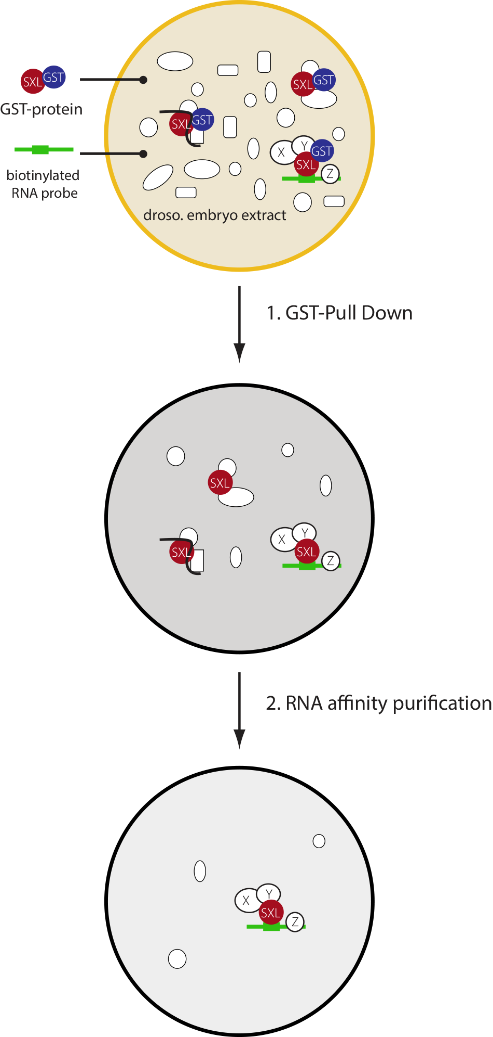
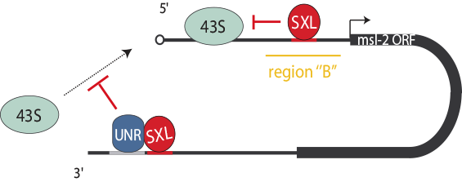
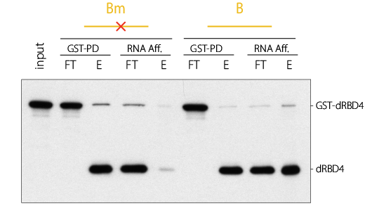
Two-steps mRNP purification : GST-pull down + RNA affinity purification
Purification of 5’UTR associated SXL

Slide 14
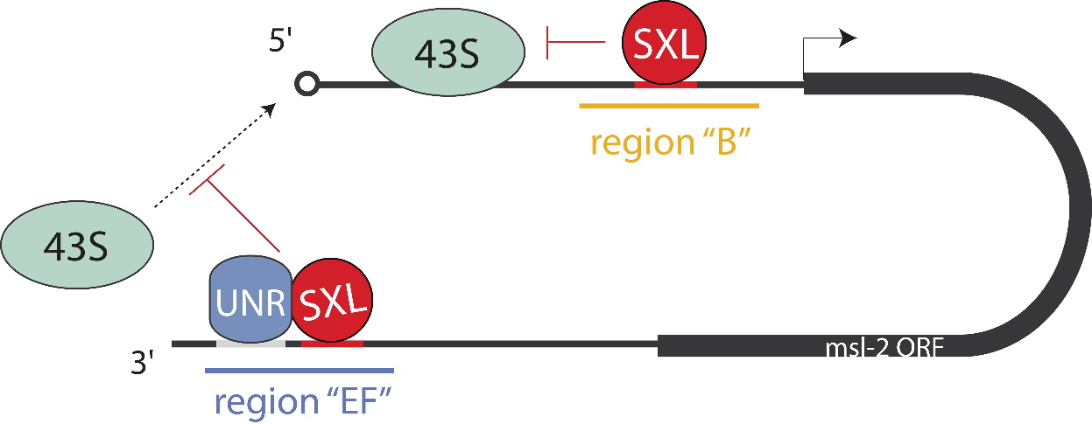
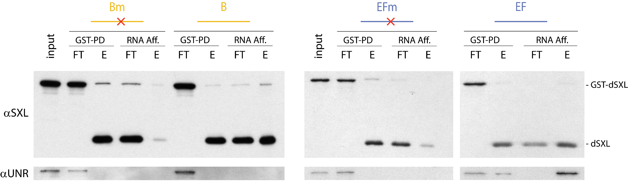
Puriication of SXL mRNP complexes
Two-steps mRNP purification : GST-pull down + RNA affinity purification
Purification of two different SXL mRNPs (5’ and 3’UTR-specific)

Slide 15
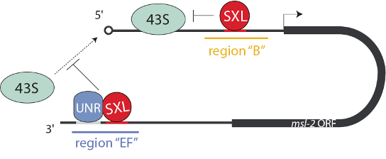
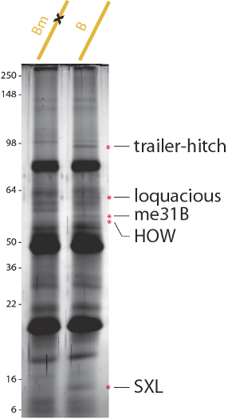
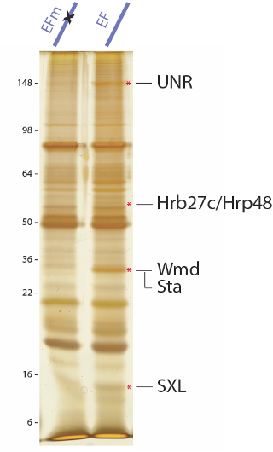
Two-steps mRNP purification : GST-pull down + RNA affinity purification
Four candidates co-factors
Three candidates co-factors
in the 5’UTR
in the 3’UTR (+UNR)
Identification of SXL candidate co-factors

Slide 16
Plan
Identification of SXL interactions
Introduction
(a) Dosage compensation and the need to repress Msl2 in females
(b) Translation initiation
(c) The paradigm of msl2 translational repression
Purification of SXL mRNP complexes
(d) Two-steps mRNP purification
(e) 5’UTR SXL co-factor: Held-Out-Wing
(f) 3’UTR SXL co-factor: Hrp48
SXL mRNA targets: Seeking for genes involved in sex determination
(g) Introduction
(h) mRNAs interacting with SXL
(i) Perspectives

Slide 17
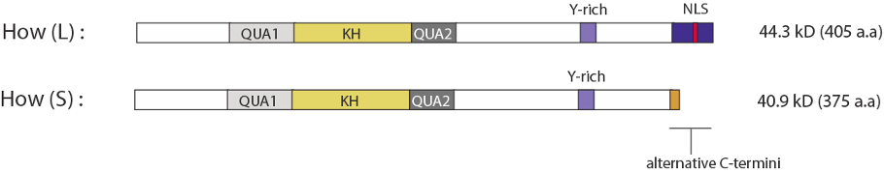
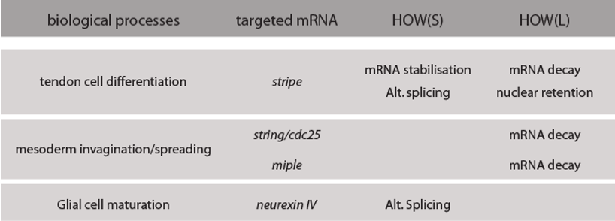
5’UTR co-factor: Hold-Out-Wing
HOW = RNA binding protein involved in mRNA processing
Two characterized isoforms:
Biological functions / molecular mechanisms:

Slide 18
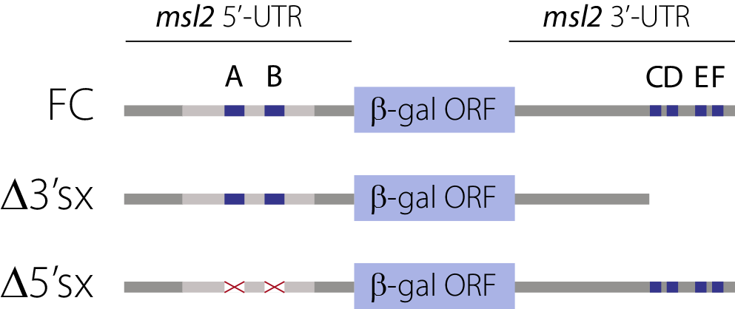
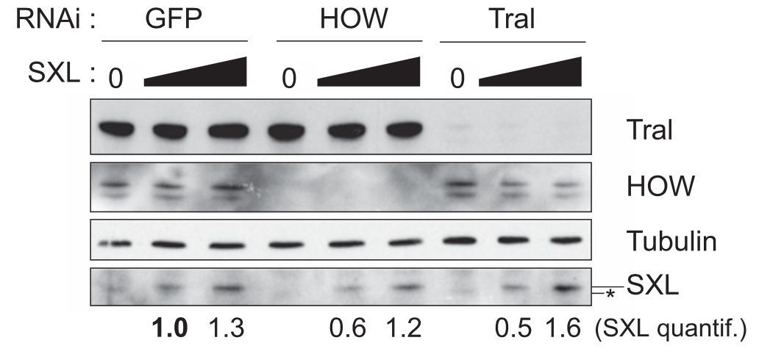
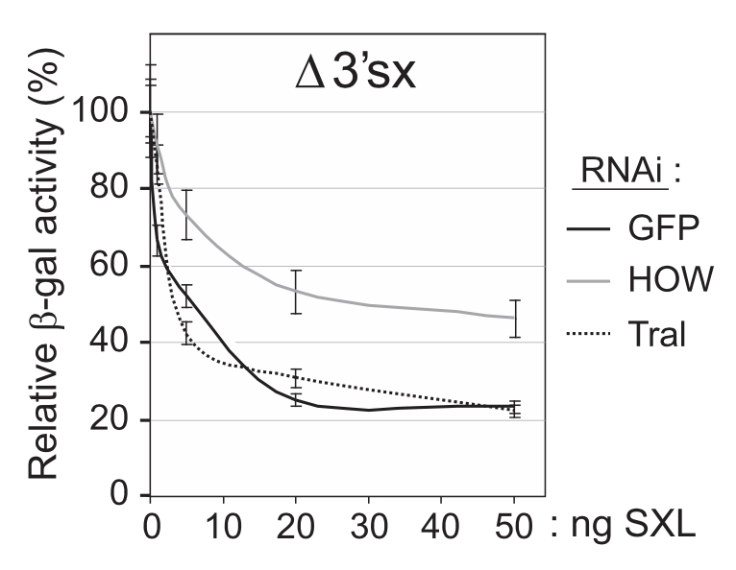
5’UTR co-factor: Hold-Out-Wing
In vitro translation assays in HOW RNAi cells:
HOW RNAi impairs SXL-mediated repression through msl2 5’UTR

Slide 19
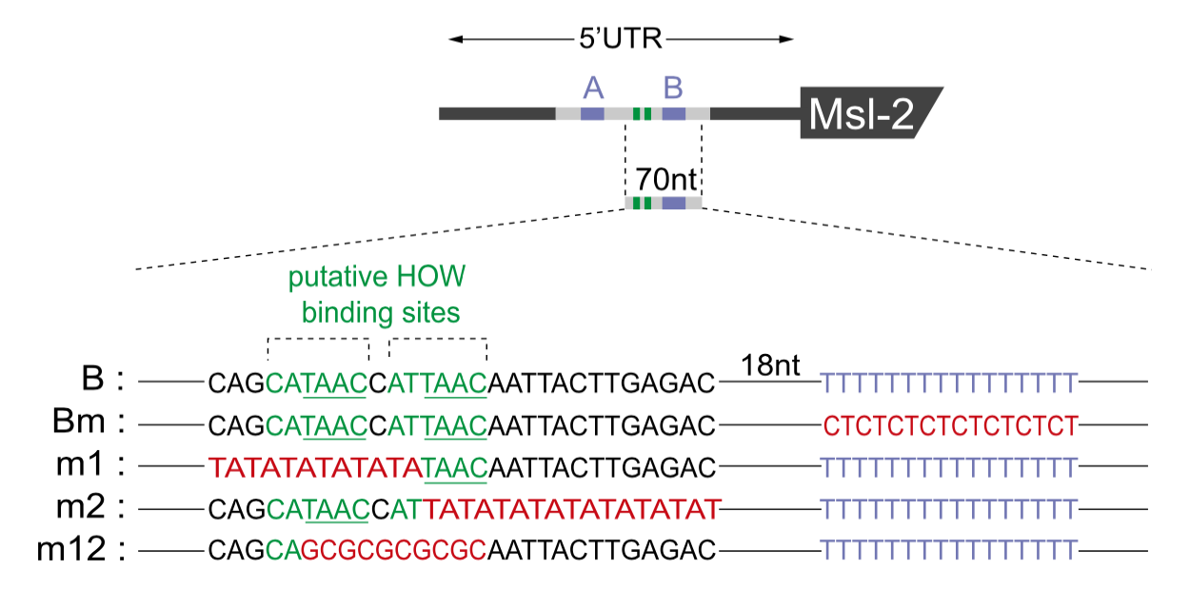
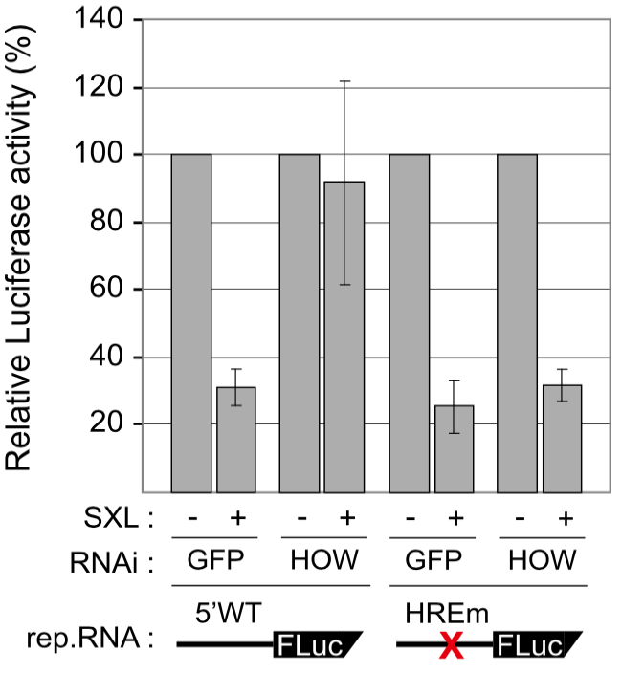
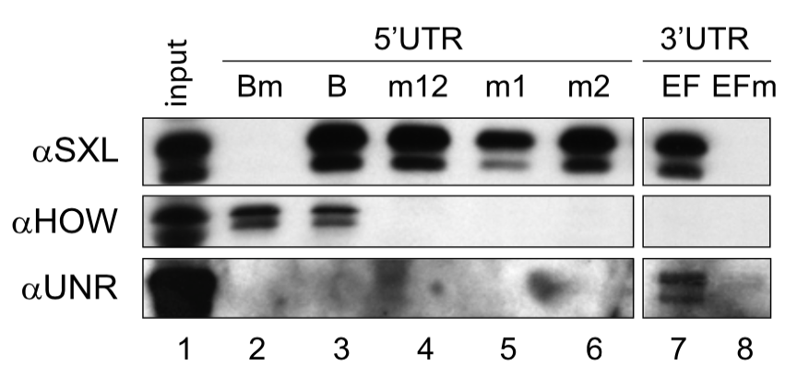
5’UTR co-factor: Hold-Out-Wing
Potential HOW Responsive Elements (HRE) present in msl2 5’UTR
HOW binding to HREs mediates msl2 silencing

Slide 20
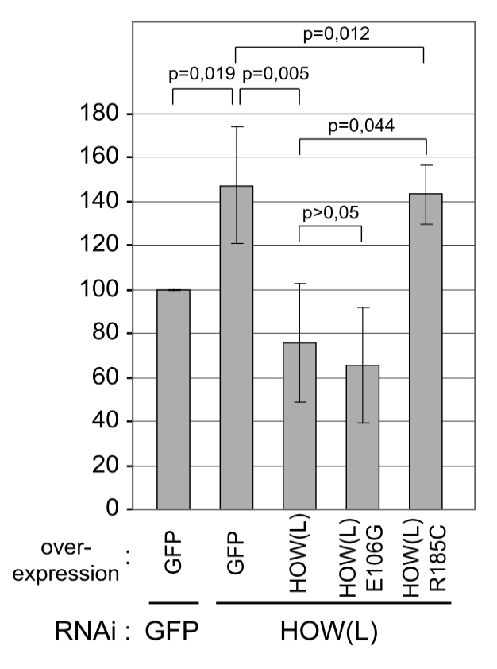
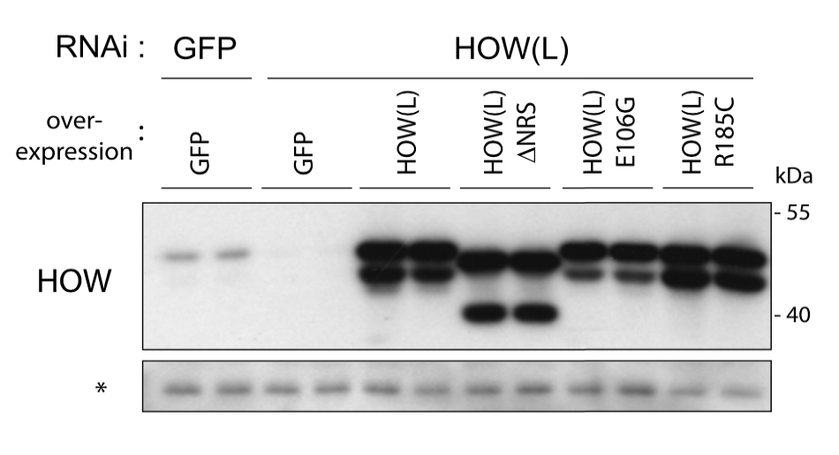
5’UTR co-factor: Hold-Out-Wing
HOW(L) and mutants overexpression in HOW-depleted cells:
HOW(L), but not mutants lacking RNA binding activity, restore msl2 silencing

Slide 21
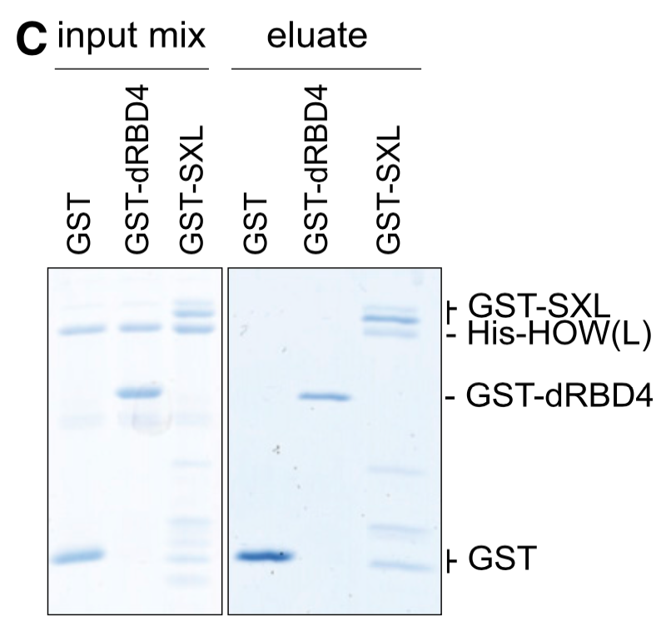
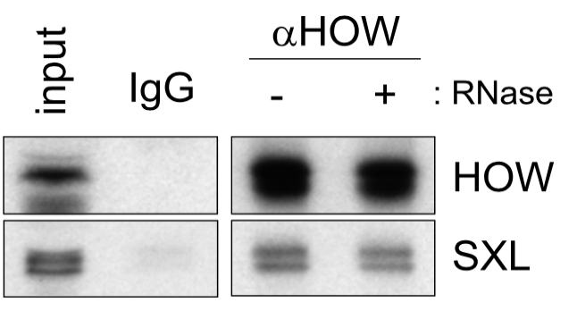
5’UTR co-factor: Hold-Out-Wing
Study of HOW and SXL interaction:
HOW and SXL interact directly, in the absence of RNA

Slide 22
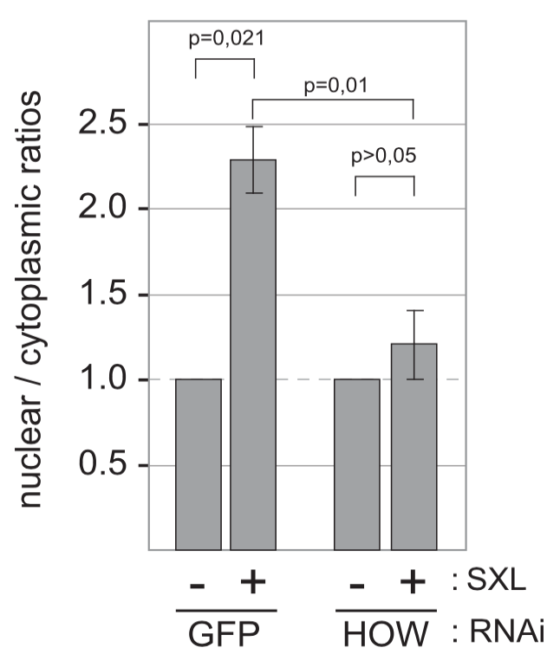
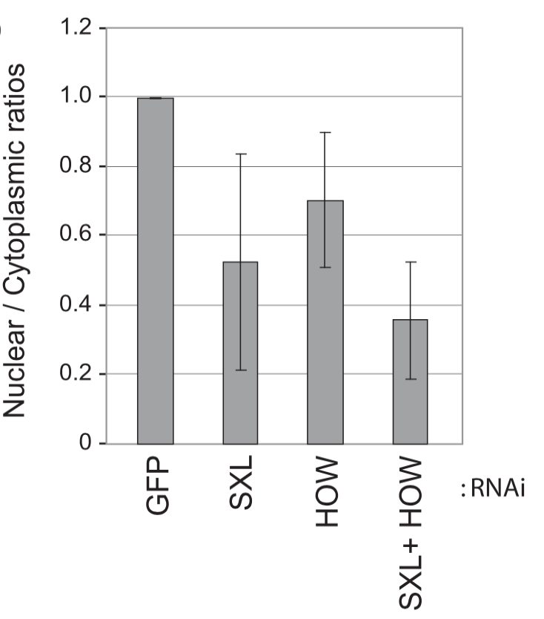
5’UTR co-factor: Hold-Out-Wing
Mechanism of HOW for msl2 silencing:
HOW cooperates with SXL
SXL and HOW cause nuclear accumulation
to promote nuclear mRNA retention
of endogenous msl2 mRNA

Slide 23
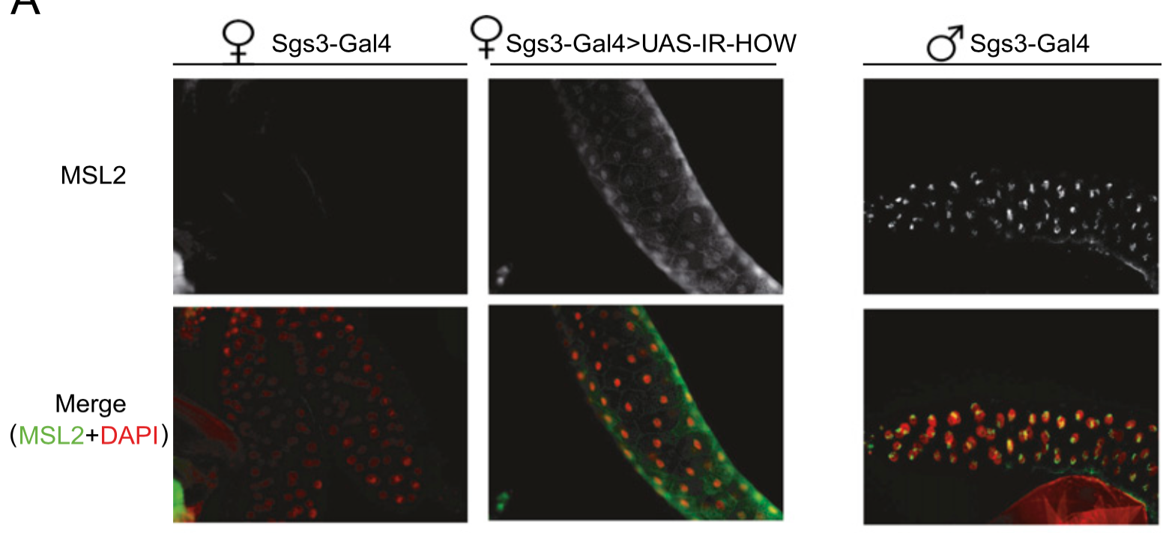
5’UTR co-factor: Hold-Out-Wing
Effect of HOW depletion on msl2 in vivo:
HOW cooperates with SXL to repress msl2 expression in Drosophila larvae

Slide 24
Plan
Identification of SXL interactions
Introduction
(a) Dosage compensation and the need to repress Msl2 in females
(b) Translation initiation
(c) The paradigm of msl2 translational repression
Purification of SXL mRNP complexes
(d) Two-steps mRNP purification
(e) 5’UTR SXL co-factor: Held-Out-Wing
(f) 3’UTR SXL co-factor: Hrp48
SXL mRNA targets: Seeking for genes involved in sex determination
(g) Introduction
(h) mRNAs interacting with SXL
(i) Perspectives

Slide 25
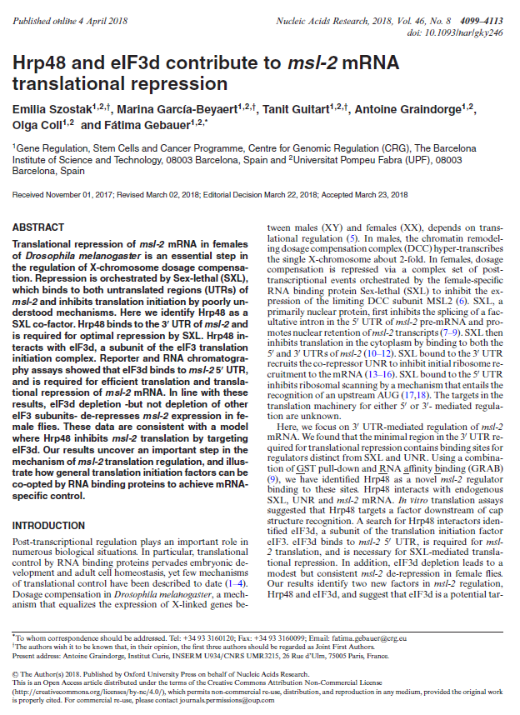
3’UTR co-factor: Hrp48
Hrp48 contributes to msl-2 translational repression
(Szostak et al, 2018)

Slide 26
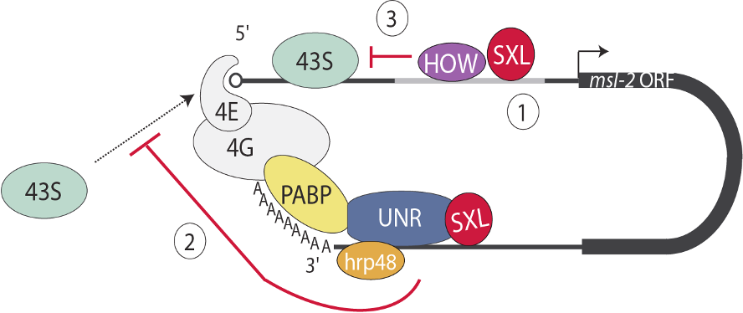
Purification of SXL mRNP complexes
1. Purification of SXL 5’- and 3’-UTR mRNPs
2. Identification of HOW (5’UTR) and Hrp48 (3’UTR) as involved in msl2 silencing

Slide 27
Plan
Identification of SXL interactions
Introduction
(a) Dosage compensation and the need to repress Msl2 in females
(b) Translation initiation
(c) The paradigm of msl2 translational repression
Purification of SXL mRNP complexes
(d) Two-steps mRNP purification
(e) 5’UTR SXL co-factor: Held-Out-Wing
(f) 3’UTR SXL co-factor: Hrp48
SXL mRNA targets: Seeking for genes involved in sex determination
(g) Introduction
(h) mRNAs interacting with SXL
(i) Perspectives

Slide 28
SXL mRNA targets: Seeking for genes involved in sex determination
Other
2
mRNAs?
In collaboration with T. Derrien / R. Guigo’s lab
(Adapted from Penalva and Sanchez, 2003)

Slide 29
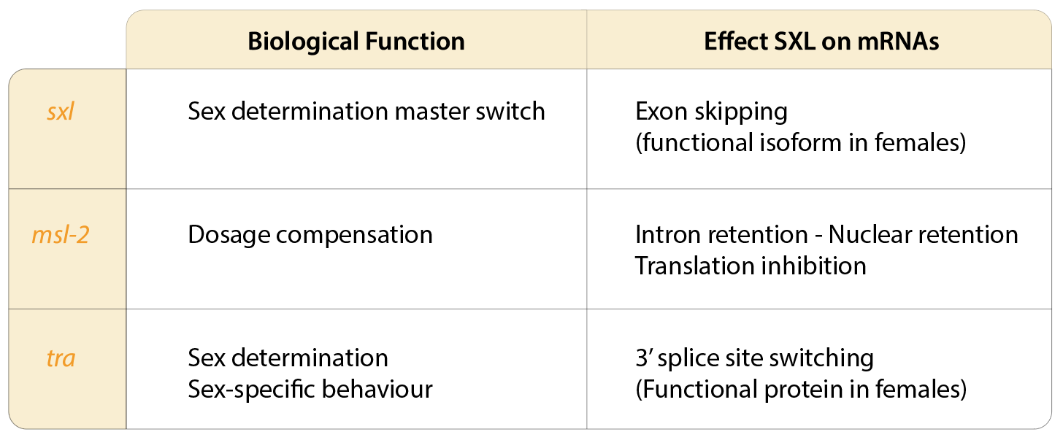
SXL mRNA targets: Seeking for genes involved in sex determination
Described SXL mRNA targets:

Slide 30
SXL mRNA targets: Seeking for genes involved in sex determination
Project: Identification of mRNAs translationally silenced by SXL
Step 1: mRNAs interacting with SXL
- SXL immunopurification
- co-purified mRNA identification (SOLEXA sequencing)
Step 2: Functional high-throughput screening
- SXL RNAi in Kc cells + polysome gradients
- identification of mRNAs associated with polysomes upon SXL RNAi
Step 3: Genetic validation of the candidate mRNAs
- Overlap between binding screening (step1) and functions screening (step2)
- Looking for sex-specific phenotype in mutant flies

Slide 31
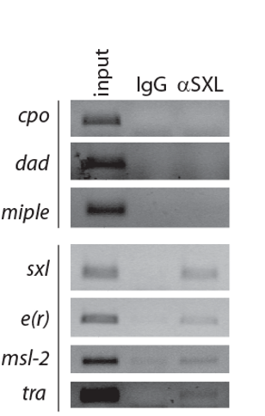
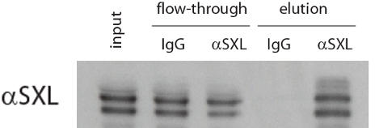
SXL mRNA targets: mRNAs interacting with SXL
SXL and target mRNAs co-immunopurification:
SXL immunopurification:
mRNA co-purification:
SXL and associated mRNA are enriched
Fractions sent to SOLEXA sequencing

Slide 32
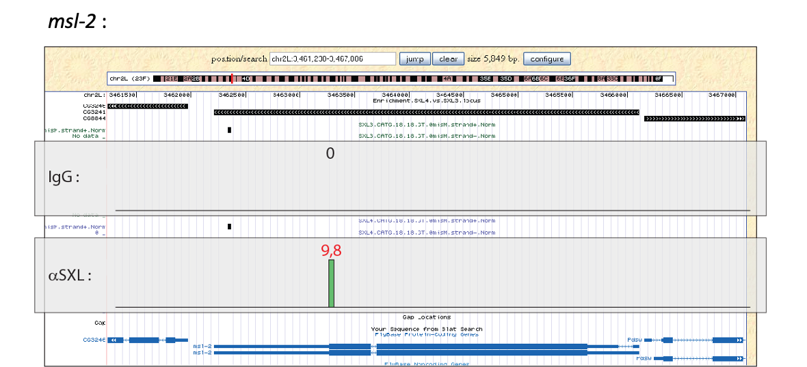
SXL mRNA targets: mRNAs interacting with SXL
Exploration of mRNAs co-purified with SXL (USCS genome browser):
Internal control msl2 mRNA is enriched with SXL

Slide 33
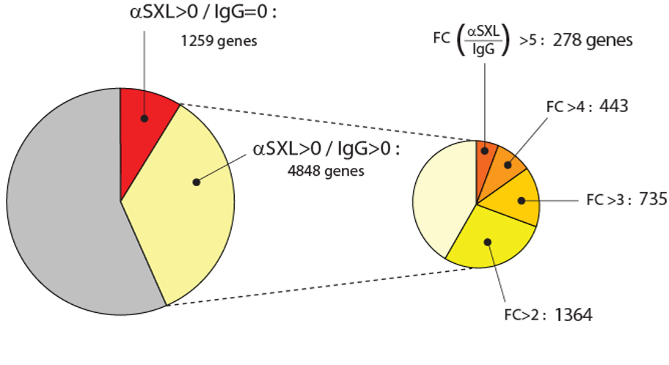
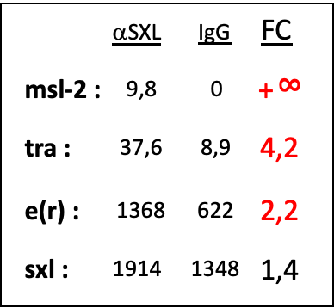
SXL mRNA targets: mRNAs interacting with SXL
Preliminary results on 14.058 genes:
Identification of candidate mRNAs interacting with SXL

Slide 34
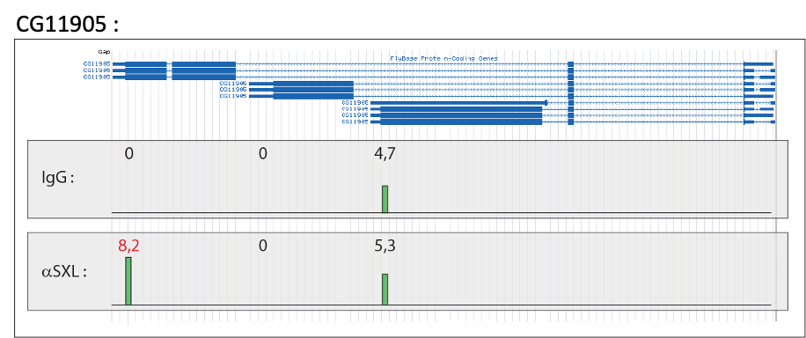
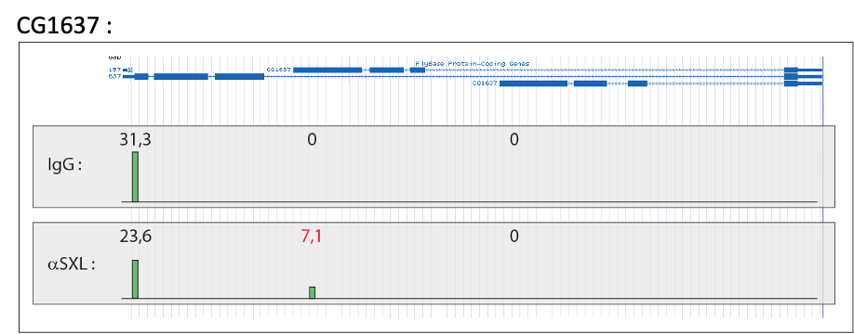
SXL mRNA targets: mRNAs interacting with SXL
Exploration of transcripts co-purified with SXL (USCS genome browser):
Isoform-specific enrichment with SXL

Slide 35
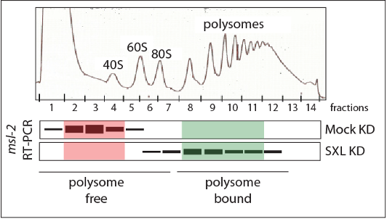
SXL mRNA targets: Functional high-throughput screening (Perspectives)
Which mRNAs are translationally repressed in a SXL-dependent manner?
1. SXL Knock-down in Kc cells
2. Polysomes/subpolysomes separation
Expected msl2 polysome profile:
3. mRNA sequencing of the appropriate fractions
4. Identify the mRNAs that get translated upon SXL RNAi

Slide 36
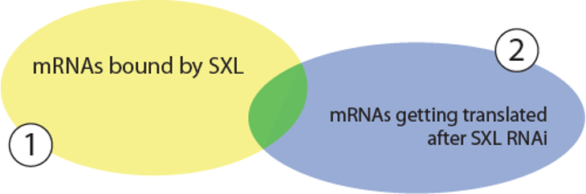
SXL mRNA targets: Functional high-throughput screening (Perspectives)
Genetic validation of the candidates mRNAs:
Subset of mRNAs of interest
Involved in sex determination ?
Sex-specific development
Sex-specific behaviour
Dosage compensation

Slide 37
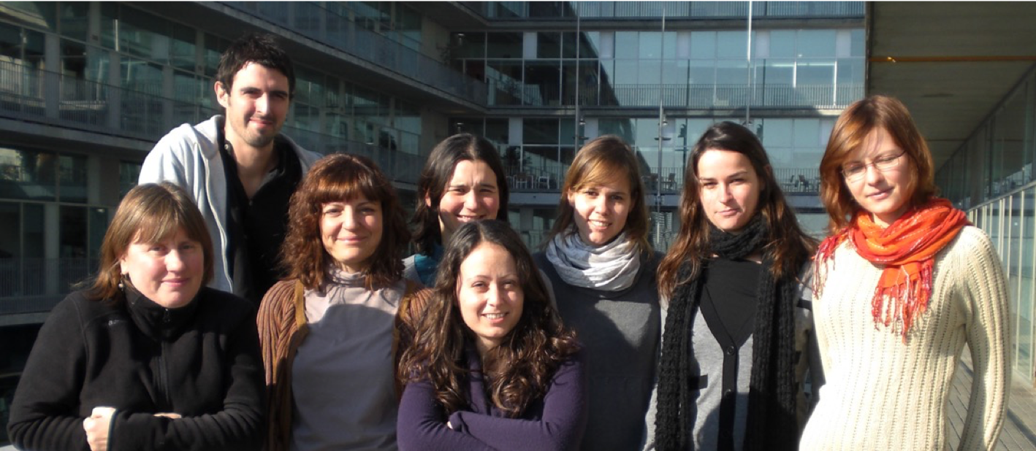

Thanks!
Fatima Gebauer Lab
Olga Coll
Marina Garcia
Cristina Militti
Anna Ribo
Emilia Szostak
Ana Villalba
Laurence Wurth
Collaboration CRG:
Thomas Derrien
Roderic Guigo

Slide 39
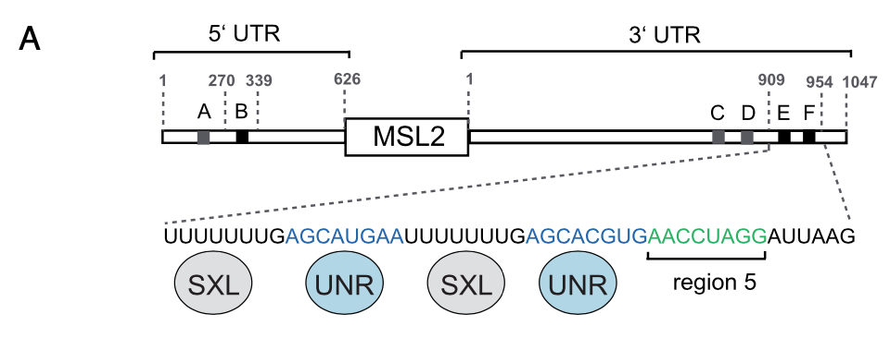


3’UTR co-factor: Hrp48
Hrp48 binding site:
WT
EFm
5m
Hrp48 binds to msl2 region 5
(Szostak et al, 2018)

Slide 40



3’UTR co-factor: Hrp48
Reporter RNA silencing in Hrp48-depleted extracts:
Hrp48 contributes to msl2 translational repression
(Szostak et al, 2018)

Slide 41


3’UTR co-factor: Hrp48
Hrp48 interactions:
Hrp48 interacts with components
Hrp48 binding sequence
of the msl2 repressor complex
interacts with eIF3d
(Szostak et al, 2018)

Slide 42

3’UTR co-factor: Hrp48
eIF3d RNAi in Drosophila salivary glands:
eIF3d depletion de-represses msl2 in vivo
(Szostak et al, 2018)

